Slide 1

Business Logic, simplified Pitch Deck
Business Logic As A Service

Slide 2

01
BaaS

Slide 3
Introduction
Miradi plc
BaaS
New kid on the block.
Not typical.
Registation ongoing.
SaaS for business logic.
No Code.

Slide 4


Scattered Logic
Big boss. Can you trace, explain or update your business logic on demand :-
Without coding ?
Without the vendor ?
While explaining each step in the computation ?
From the comfort of your home or on vacation ?
THE TRUTH: Changes take weeks, QA cycles then redeployment and hope it works !

Slide 5
the need for speed
E commerce
Micro Finance
Change discount logic before a flash sale goes live in the next few minutes.
Adjust deposit and withdrawal rules instantly for compliance or when anticipating malpractice.
Healthcare
Insurance
Roll out compliance-driven changes overnight.
Adjust premium calculation formulas, rates and exclusions in minutes, not weeks.

Slide 6
Business logic As A Service
For Staff
Organization
Tech
Explain the rules.
Justify the calculations.
Update the rules, the steps.
No code.
Own the logic.
Move fast.
React fast.
Be first.
Access the logic via API.
Single point of reference.
Low code.

Slide 7
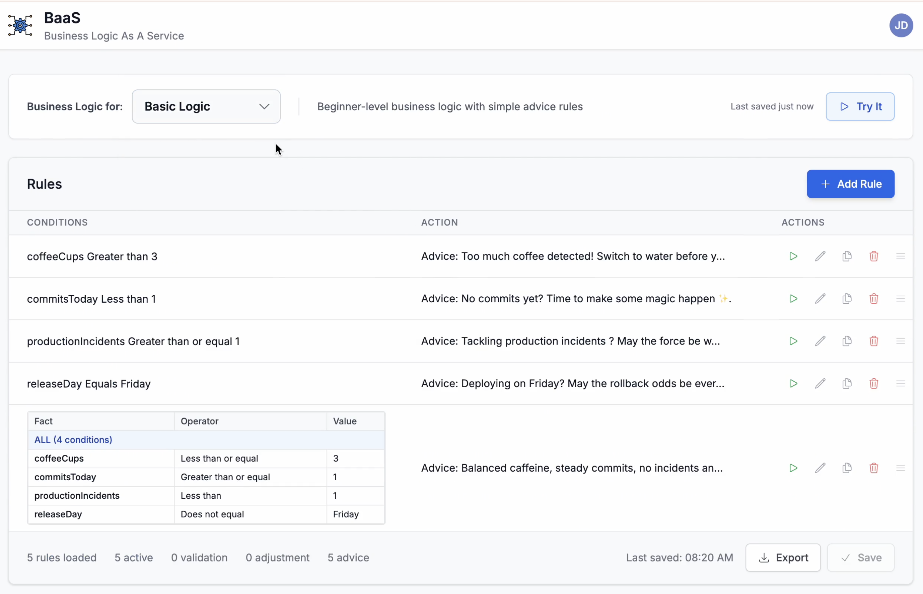
Basic Logic
Features
Simple validation and advice workflows. No code.
Users
Beginners. Try rules and execution sequence.
Value
Understand logic and why each event is triggered.

Slide 8
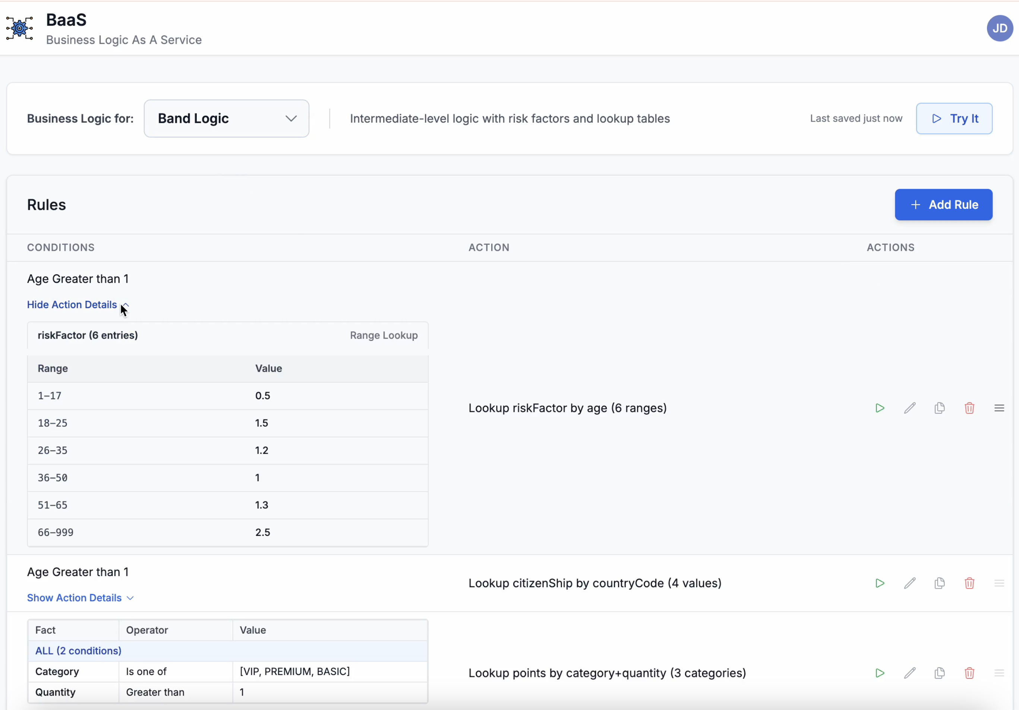
Band Logic
Features
Mix basic and tabular logic. Supports range and value lookups.
Users
Business Analysts, Subject Matter Experts.
Value
Realistic and works for majoritiy of the use cases.

Slide 9
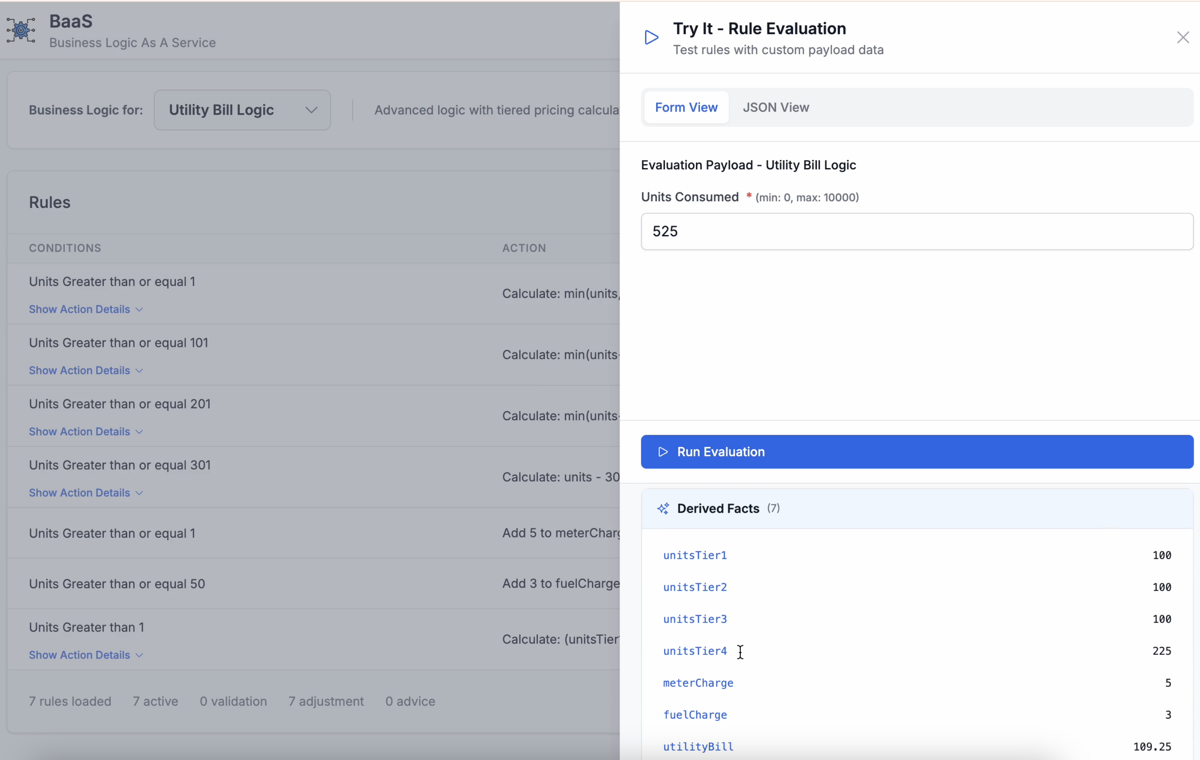
Advanced Logic
Features
Support for common math expressions. Low code
Users
Business Analysts, Tech Support, System Integrators.
Value
Flexibility. Support for highly technical rules.

Slide 10

On Prem
Higher Privacy, Security.
Subscription
Faster, always up to date.
Freemium
Free tier with limited features.

Slide 11
333,000
Users bought our product
9h 55m 23s
Estimated delivery time per unit
386,000 km
Avg. distance travelled by logistics team

Slide 12
The Problem
Keep it simple
Use visuals
Keep it short
Structure your pitch deck clearly and make sure all the important points are easy to understand
Incorporate visuals or graphics to illustrate your message and keep the audience engaged
A good pitch deck should be concise and clear; avoid trying to cram in too much information
Make it memorable
Test & iterate
Main points
Include impactful stories, statistics, or facts that will help your audience remember your
message afterwards
Practice presenting your deck beforehand with friends or colleagues for feedback, then use this input to refine it further
A pitch deck is an overview of your business; focus on key points that get the most important ideas across

Slide 13
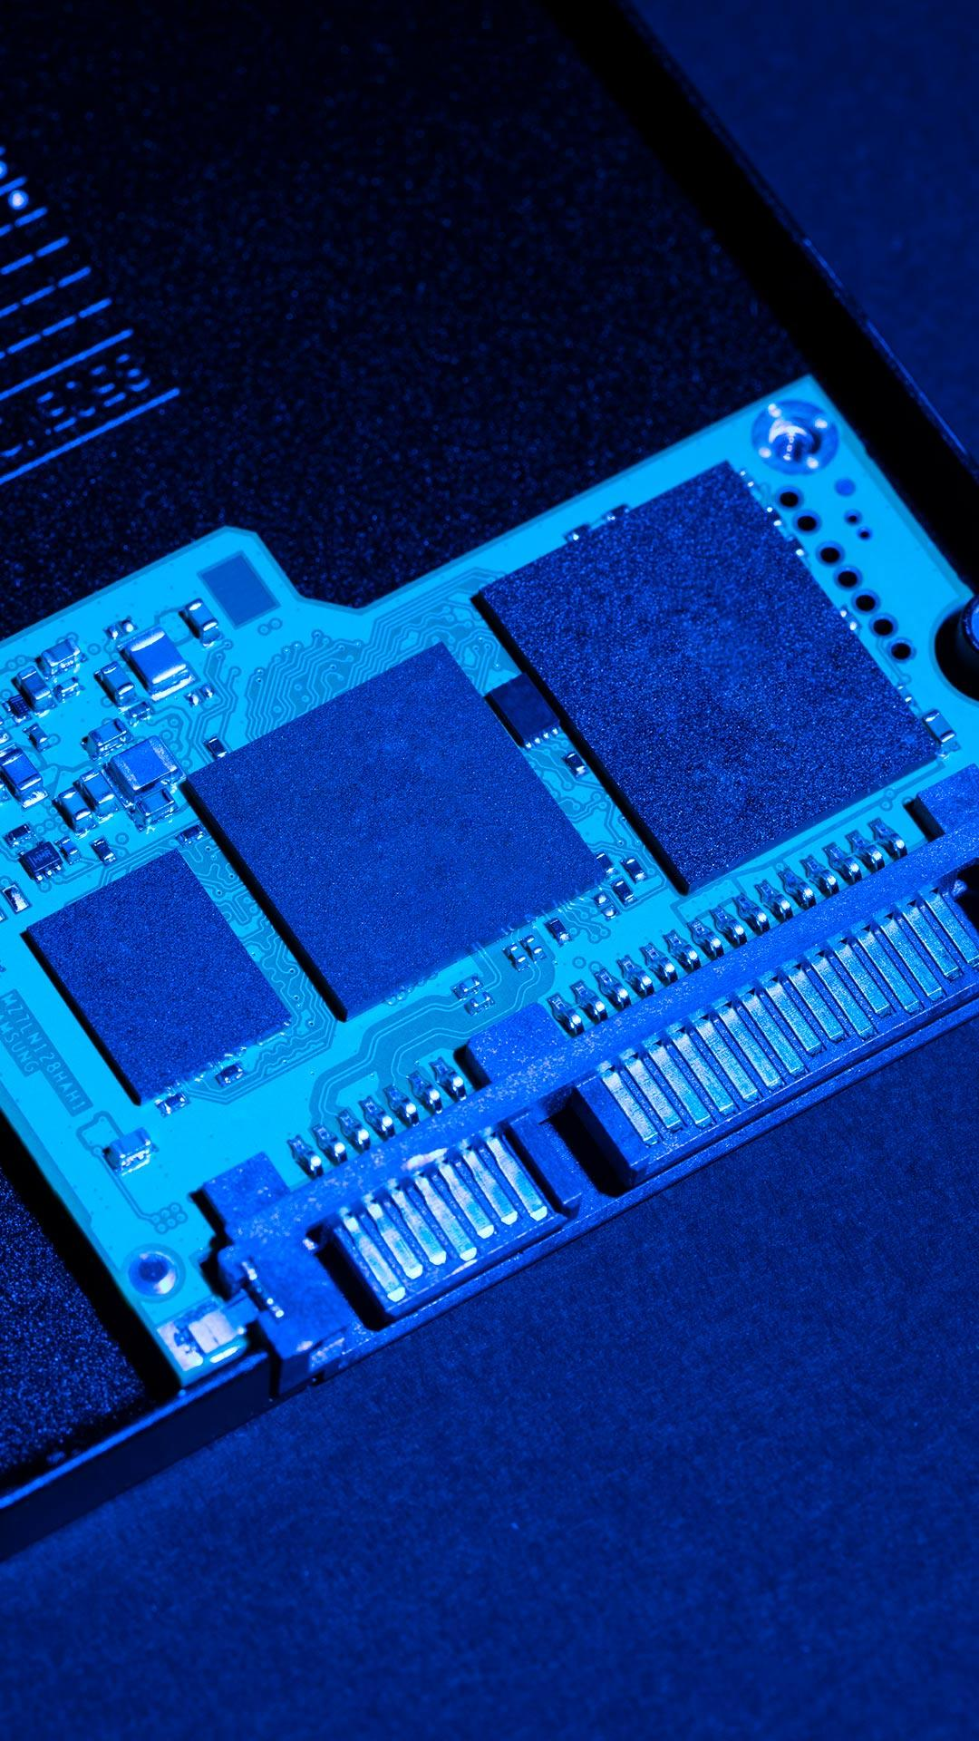
Delivery
Visuals
Features
Showcase the design of your product
What makes you product unique?
Price
Users
Share the cost and price with investors
Speak about the target audience
Availability
Updates
When is the product expected to be ready?
Do you plan on updating it?

Slide 14
4,498,300,000
Number of users analyzed in our market research

Slide 15
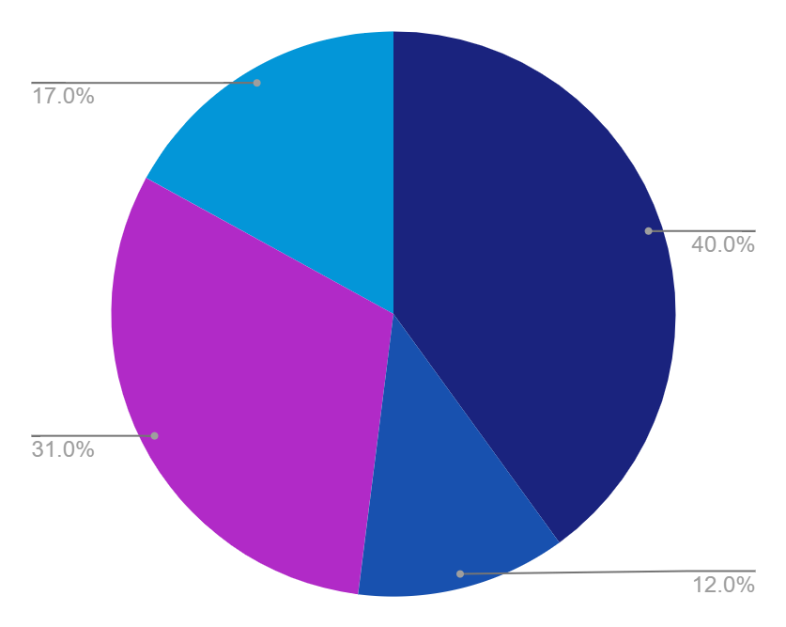
Revenue by quarter
Q4
Q1
October - December
January - March
Q3
Q2
July - September
April - June
Follow the link in the graph to modify its data and then paste the new one here. For more info, click here

Slide 16
Competition comparison
 | Features | Value | Pricing | Trial | Competence | Share
Company A | Fuel economy | Special offers | $23,000 | No | Low | 8%
Company B | Design | Reliability | $27,000 | No | Low | 5%
Company C | Performance | Repairs | $30,000 | Yes | High | 20%
Company D | Safety features | Marketing | $24,000 | No | High | 22%
Company E | Technology | Customers | $32,000 | Yes | Low | 10%
Company F | Comfort | Best prices | $15,000 | Yes | High | 30%
Company G | Customization | Brand name | $45,000 | No | Low | 5%

Slide 17
Timeline of your presentation
01
02
03
04
Provide a brief overview of the pitch deck's content
Engage the audience with a compelling introduction
Identify the customer's pain points
and challenges
Describe how your product or service can solve the problem
05
06
07
08
Highlight the unique value proposition and benefits of your specific solution
Analyze the target market size, growth potential, and competition briefly
Explain your financial needs and briefly outline your
funding allocation
End with a clear and concise call to action

Slide 18

Organizational chart
Jane Doe
CEO
John Smith
Sales Manager
Maya Willson
Project Manager
Tom James
Administration
Emma Miller
Sales
Richard Taylor
Director
Sarah Williams
Assistant
Steven Ander
Secretary
Brian Clark
Employee
Michelle Garcia
Employee
James Scott
Employee
William Young
Employee

Slide 19
Market size overview
$110m
Include the total size of the market, which represents the entire potential customer base for the product or service
$25m
Identify the target market for the product or service, which may be a subset of the total market. This could be based on factors such as demographics, geography, or specific needs
$6m
Indicate the current market size, which represents the portion of the target market that the company has successfully captured

Slide 20
Roadmap infographic
Initiative | Objective | Jan | Feb | Mar | Apr | May | Jun | Jul | Aug | Sep | Oct | Nov | Dec
Understanding | Analyze and understand the needs of your target audience
Conduct research | Research existing products in the industry and analyze how successful they are
Brainstorm ideas | Generate ideas based on user feedback and research findings
Develop a prototype | Create a basic version of the product to show investors
Test for usability | Put the prototype through rigorous testing processes to ensure that it meets user requirements
Analyze feedback | Understand the opinion of the users who tried your product

Slide 21

KPI dashboard
$4,000,000
$100,000
$5,000
Product | Units | Revenue | Returns
Item 1 | 500 | 2,000,000 | 40
Item 2 | 1,000 | 50,750 | 10
Item 3 | 250 | 1,500,000 | 300
Item 4 | 500 | 2,000,000 | 40
Item 5 | 1,000 | 50,750 | 10
Item 6 | 250 | 1,500,000 | 300
Item 7 | 500 | 2,000,000 | 40
Item 8 | 1,000 | 50,750 | 10
Revenue
General costs
Profit
Follow the link in the graph to modify its data and then paste the new one here. For more info, click here

Slide 22


Thanks!
Do you have any questions?
youremail@freepik.com
+34 654 321 432
yourwebsite.com
Please keep this slide for attribution

Slide 23






Alternative resources
Here’s an assortment of alternative resources whose style fits the one of this template:
Vectors
Memphis gradient geometric shapes landing page
Gradient geometric shapes landing page

Slide 24

Resources
Did you like the resources on this template? Get them for free at our other websites:
Photos
Flat lay hard drive with blue light
Top view hard drive with blue light
Person working html on computer
Vectors
Gradient geometric shapes landing page

Slide 25
Instructions for use
If you have a free account, in order to use this template, you must credit Slidesgo by keeping the Thanks slide. Please refer to the next slide to read the instructions for premium users.
As a Free user, you are allowed to:
Modify this template.
Use it for both personal and commercial projects.
You are not allowed to:
Sublicense, sell or rent any of Slidesgo Content (or a modified version of Slidesgo Content).
Distribute Slidesgo Content unless it has been expressly authorized by Slidesgo.
Include Slidesgo Content in an online or offline database or file.
Offer Slidesgo templates (or modified versions of Slidesgo templates) for download.
Acquire the copyright of Slidesgo Content.
For more information about editing slides, please read our FAQs or visit our blog:
https://slidesgo.com/faqs and https://slidesgo.com/slidesgo-school

Slide 26
Instructions for use (premium users)
As a Premium user, you can use this template without attributing Slidesgo or keeping the "Thanks" slide.
You are allowed to:
Modify this template.
Use it for both personal and commercial purposes.
Hide or delete the “Thanks” slide and the mention to Slidesgo in the credits.
Share this template in an editable format with people who are not part of your team.
You are not allowed to:
Sublicense, sell or rent this Slidesgo Template (or a modified version of this Slidesgo Template).
Distribute this Slidesgo Template (or a modified version of this Slidesgo Template) or include it in a database or in any other product or service that offers downloadable images, icons or presentations that may be subject to distribution or resale.
Use any of the elements that are part of this Slidesgo Template in an isolated and separated way from this Template.
Register any of the elements that are part of this template as a trademark or logo, or register it as a work in an intellectual property registry or similar.
For more information about editing slides, please read our FAQs or visit our blog:
https://slidesgo.com/faqs and https://slidesgo.com/slidesgo-school

Slide 27
Fonts & colors used
This presentation has been made using the following fonts:
DM Sans
(https://fonts.google.com/specimen/DM+Sans)
Open Sans
(https://fonts.google.com/specimen/Open+Sans)
#ffffff
#b12ac7
#1a237e
#0396d8
#1851af

Slide 28





Storyset
Create your Story with our illustrated concepts. Choose the style you like the most, edit its colors, pick the background and layers you want to show and bring them to life with the animator panel! It will boost your presentation. Check out how it works.
Pana
Amico
Bro
Rafiki
Cuate

Slide 29
Use our editable graphic resources...
You can easily resize these resources without losing quality. To change the color, just ungroup the resource and click on the object you want to change. Then, click on the paint bucket and select the color you want. Group the resource again when you’re done. You can also look for more infographics on Slidesgo.

Slide 32
JANUARY
FEBRUARY
MARCH
APRIL
MAY
JUNE
PHASE 1
Task 1
Task 2
PHASE 2
Task 1
Task 2
JANUARY
FEBRUARY
MARCH
APRIL
PHASE 1
Task 1
Task 2

Slide 35
...and our sets of editable icons
You can resize these icons without losing quality.
You can change the stroke and fill color; just select the icon and click on the paint bucket/pen.
In Google Slides, you can also use Flaticon’s extension, allowing you to customize and add even more icons.

Slide 36
Educational Icons
Medical Icons

Slide 37
Business Icons
Teamwork Icons

Slide 38
Help & Support Icons
Avatar Icons

Slide 39
Creative Process Icons
Performing Arts Icons

Slide 40
Nature Icons

Slide 41
SEO & Marketing Icons

Slide 42


